Slide 1


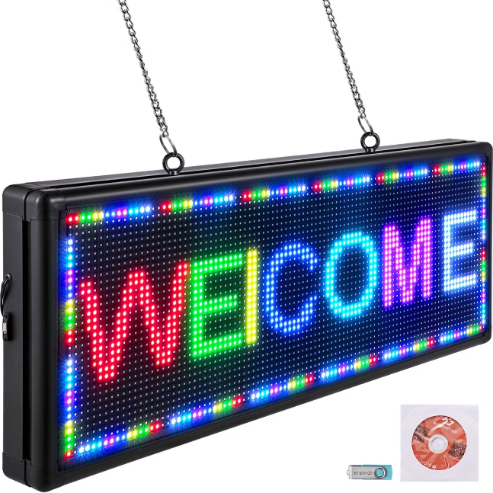
SMS Controlled Smart Notice Board
Welcome to My presentation about an innovative project: an SMS controlled smart notice board. This project leverages natural language processing (NLP) to enable users to control a digital notice board using SMS messages.
By
M.Hithesh Babu
192211166

Slide 2

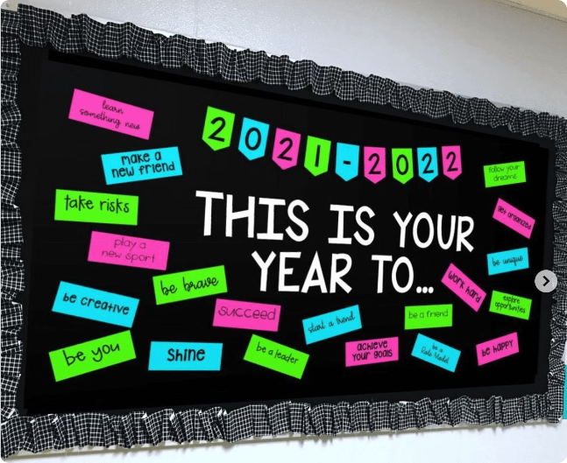
Project Overview and Objectives
This project aims to develop an innovative SMS controlled smart notice board, leveraging the power of natural language processing (NLP) to enhance communication and information sharing.
The primary objective is to create a user-friendly and accessible platform that enables users to effortlessly update the notice board with relevant information by sending simple text messages.

Slide 3

Natural Language Processing (NLP) Techniques
NLP techniques are essential for understanding and interpreting the SMS messages received by the smart notice board.
The system utilizes advanced NLP algorithms, including text preprocessing, sentiment analysis, and intent recognition, to accurately extract meaningful information from the messages.

Slide 4
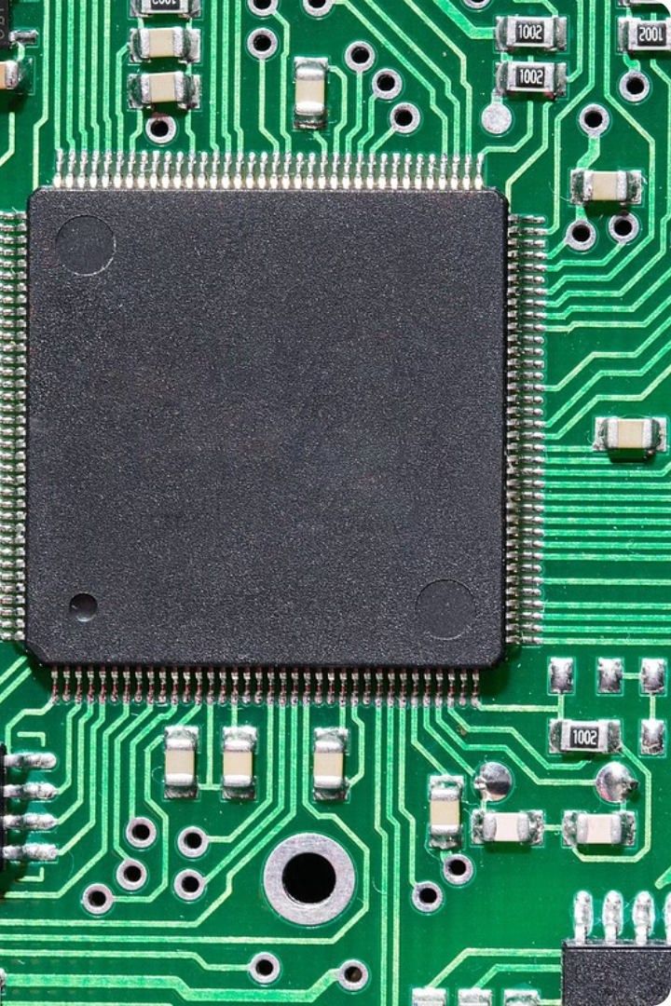
Hardware Components and Architecture
The SMS Controlled Smart Notice Board relies on a robust hardware infrastructure to receive and process SMS messages and display information effectively.
The central component is a microcontroller, which acts as the brain of the system. It is responsible for handling communication protocols, managing input/output operations, and controlling the display.

Slide 5

SMS Integration and Message Parsing
This section discusses the integration of SMS functionality into the smart notice board system. We'll explore how the system receives, parses, and interprets SMS messages.

Slide 6
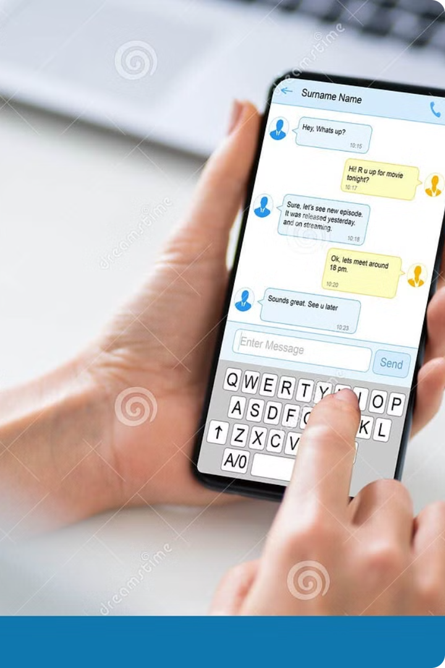
Dynamic Content Display and Updating
The notice board seamlessly displays the dynamic content received from SMS messages. It dynamically updates the display with information such as announcements, schedules, or reminders.
The system utilizes a user-friendly interface for managing content. Administrators can easily update the display, ensuring information is always current.

Slide 7

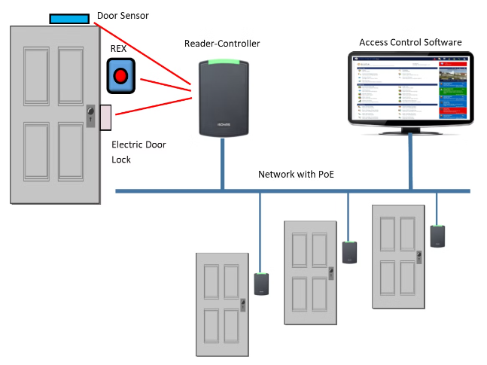
Security and Access Control
Robust security measures are essential for safeguarding the smart notice board and its sensitive content. A multi-layered approach includes user authentication, access control lists, and data encryption.
User authentication ensures that only authorized individuals can access and modify the board's content. Access control lists restrict user permissions, preventing unauthorized changes or deletions. Data encryption protects sensitive information from unauthorized access and tampering.

Slide 8

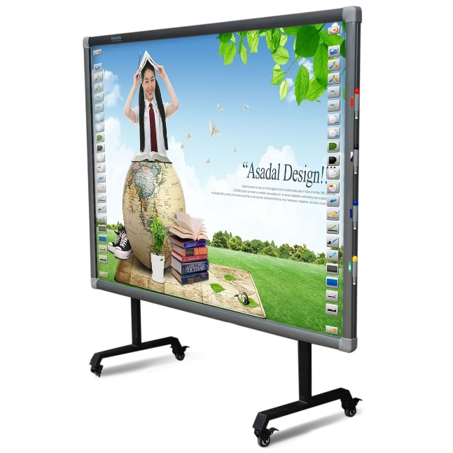
Conclusion and Future Enhancements
This SMS controlled smart notice board project offers a versatile and user-friendly solution for displaying information dynamically.
Future enhancements could include integration with external data sources, such as weather updates or traffic information, for a more comprehensive and informative experience.

Slide 9

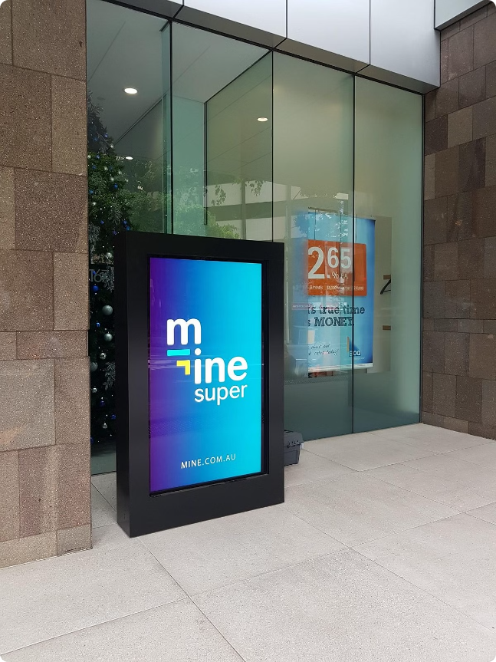
Related Work
Several research papers explore the concept of smart notice boards, focusing on different aspects such as user interface design, content management, and integration with external systems.
For example, a study on the "User Interface Design of Smart Notice Boards" investigates how to enhance user engagement and accessibility. Another research project, "Dynamic Content Management for Smart Notice Boards," explores methods for efficient content delivery and updates.

Slide 10

Thank You
We appreciate your time and interest in our presentation. We are confident that this SMS Controlled Smart Notice Board will be a valuable asset to your organization.

